Slide 1

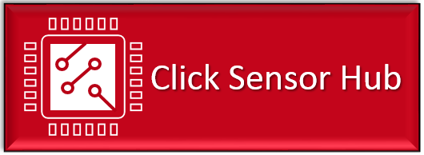
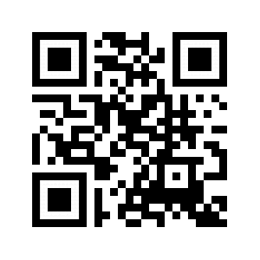

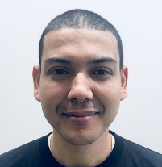

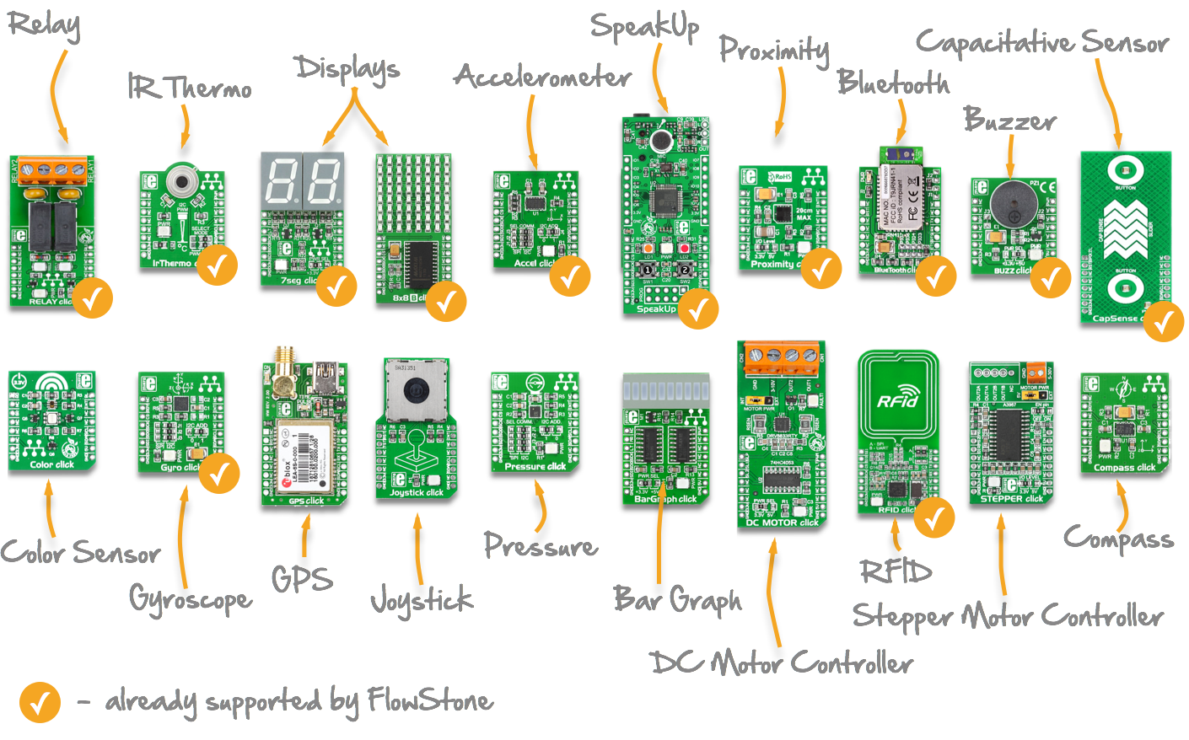
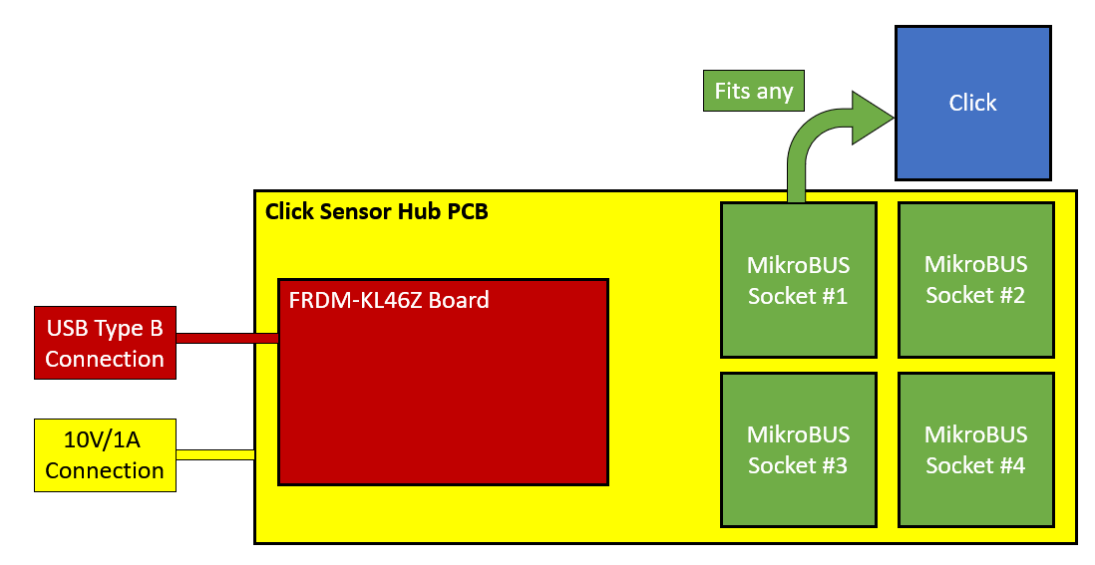
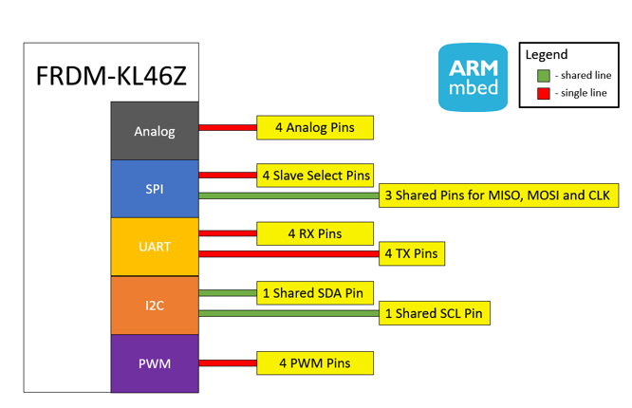
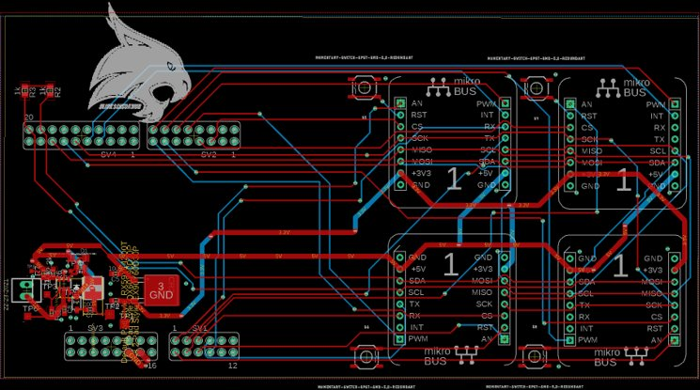
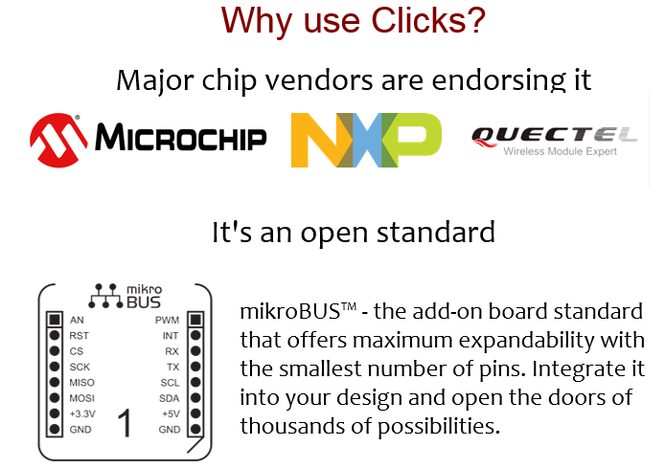
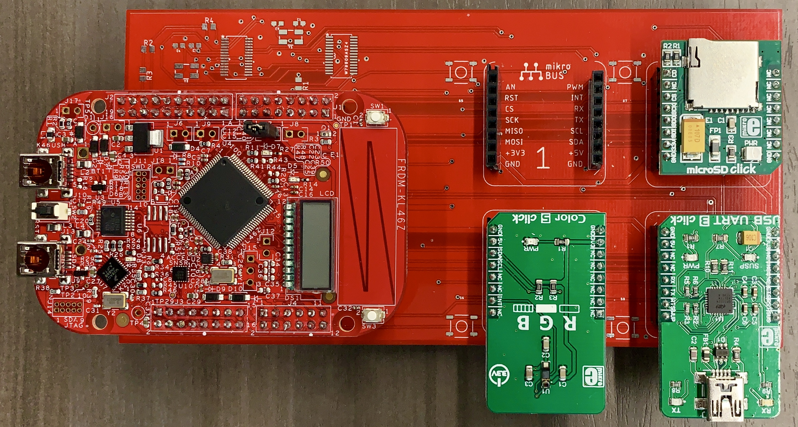
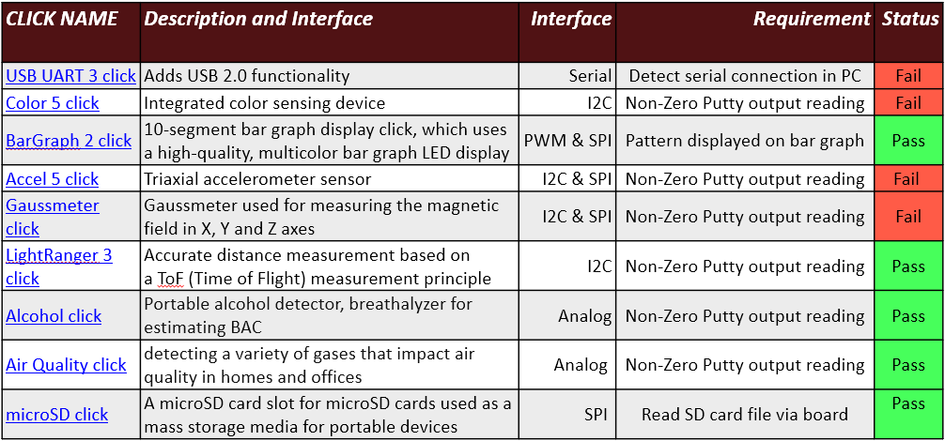
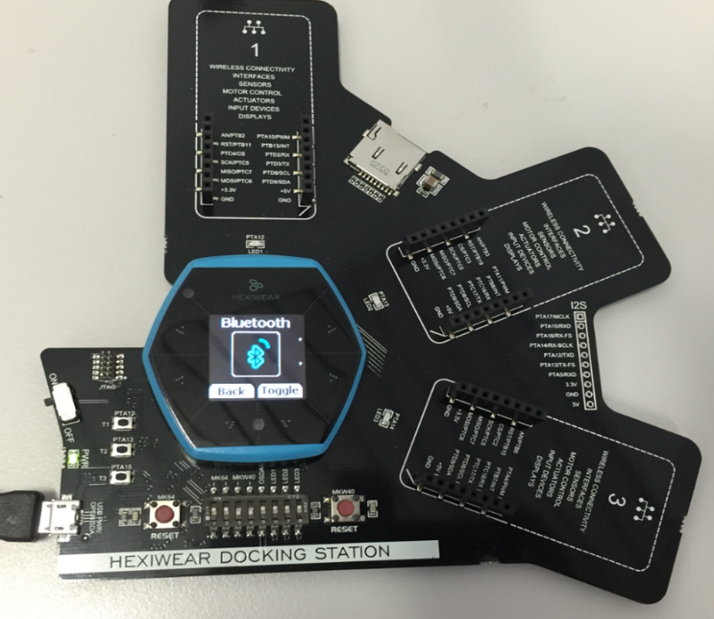

E2.08 CLICK SENSOR HUB
Alfonso De La Morena, Mohamed Sghari, Dylan Dean
PROJECT DESCRIPTION
Click Sensor Hub is an IoT development Kit, like the Hexiwear docking station. Except it utilizes NXP’s FDRM-KL46Z development platform. The KL46Z is interfaced to our designed PCB which contains four mikroBUS sockets.
PROJECT REQUIREMENTS
Connectivity between the FRDM-KL46Z and four mikroBUS sockets.
Each socket has 5V and 3.3V channel.
Successfully communicate SPI, UART, PWM, I2C, Analog. Between the PCB sockets and FRDM-KL46Z.
Write Code for Ten Clicks.
WHAT ARE CLICKS?
Click boards are plug-and-code modules designed to expand IoT functionality of development kits. These small, function-specific add-on boards all have a common interface to the mikroBUS standard.
WHY USE CLICKS?
HEXIWEAR PLATFORM
SOCKET INTERFACES
TESTING PARAMETERS
Test Case | Test Specifications | Test Results
Light Ranger 3 Click | Board powered by 3.3V connection | Connected board and checked LED light
 | Ensure safe connection to FRDM-KL46Z, no feedback voltage should be above 3.3V | Voltages of respective pins measured to be below 3.3V threshold
 | Get distance readings from Click | Non-zero reading recorded and displayed on PUTTY
ACKNOWLEDGEMENTS
NXP Semiconductors
Sponsor: Dr. Kevin Kemp
Texas State University
Faculty Advisor: Dr. Kevin Kemp
Course Instructors: Mr. Lee Hinkle and
Mr. Mark Welker

